Slide 1

Notes:
Hi Everyone,
Good Morning
Before we start with the presentation today, I would like to share a small recital.
We have been a part of Publicis Sapient for almost 3months now, and there is this fact that everyone of us would agree upon.
We all started as fresh graduates, underwent 5weeks or so of rigorous training followed by what…5 weeks now of a Hands On project, and what has transpired in these days is a fact that we all are really proud of. A transformation from someone who could code, to someone who can not only code, but add value to everything he does.
So have we succeeded at becoming a Product engineer?
Hi, I am Rajat, a small part of our big team here.
I am here with my colleagues Aman and Chinmay and we are here to give you a walkthrough of our Transformation, our Journey and the project we have been working for sometime now.

Slide 2
CRS APPLICATION
Notes:
Hi Everyone,
Good Morning
Before we start with the presentation today, I would like to share a small recital.
We have been a part of Publicis Sapient for almost 3months now, and there is this fact that everyone of us would agree upon.
We all started as fresh graduates, underwent 5weeks or so of rigorous training followed by what…5 weeks now of a Hands On project, and what has transpired in these days is a fact that we all are really proud of. A transformation from someone who could code, to someone who can not only code, but add value to everything he does.
So have we succeeded at becoming a Product engineer?
Hi, I am Rajat, a small part of our big team here.
I am here with my colleagues Aman and Chinmay and we are here to give you a walkthrough of our Transformation, our Journey and the project we have been working for sometime now.

Slide 3
The Kick Start
…..

Slide 4
Brisk Training on the FullStack Development for 4 weeks
4 weeks plan
EveryDay Discussion about topics / Techonologies / doubt clearance .
Sprint plan for the project based on the requirements shared
Every day with Trainer discussion on Project progress and transformation based on UML and Technologies
Review of the project status and guidance for Industry standard maintenance

Slide 5
Our next starts
NOW
Notes:
Time – 1 min
Swati

Slide 6
4 WEEKS OF TRAINING + PROJECT DEMO
20 DAYS
480 HOURS
28,800 MINUTES
1,728,000 SECONDS
LIMITLESS KNOWLEDGE

Slide 7

Agenda
01
Our Journey
02
Our Team
03
Team Structure
04
Project Goals
05
Engineering Practices
06
Tech Stack
07
Development
08
Challenges & Learnings
09
Demo
10
Questions
Notes:
Time – 1 min

Slide 8

Our Journey
Notes:
Time - 2 mins

Slide 9
Project Demo
5
Developement Adaption
4
Design Thinking
3
Decide the Technology
2
Understanding Project
Goals
1

Slide 10

Our Team
Notes:
Time – 2 mins

Slide 11


Bheemesh Raghupathy
Deepika
Lingala
Shiva Amancha
Shiva Mogudala
Group 2
Dinesh Kovuri
Rajneesh Kumar

Slide 12

Project Goals
Notes:
Time – 3 mins

Slide 13




Our Vision
To create a Course Registration System using JAVA/REST tools and technologies.
We will have multiple modules such as a professor, student and admin.
The major goal is it make the interaction among these modules in such a way that the purpose is served.
Another goal is to ensure the quality, security, interactivity, accessibility and speed in the application.
1
2
Quality
Security
3
4
Interactivity
Speed
Notes:
User satisfaction and brand value

Slide 14

Adapting the Best Engineering Practices
Notes:
Time – 5 mins

Slide 15
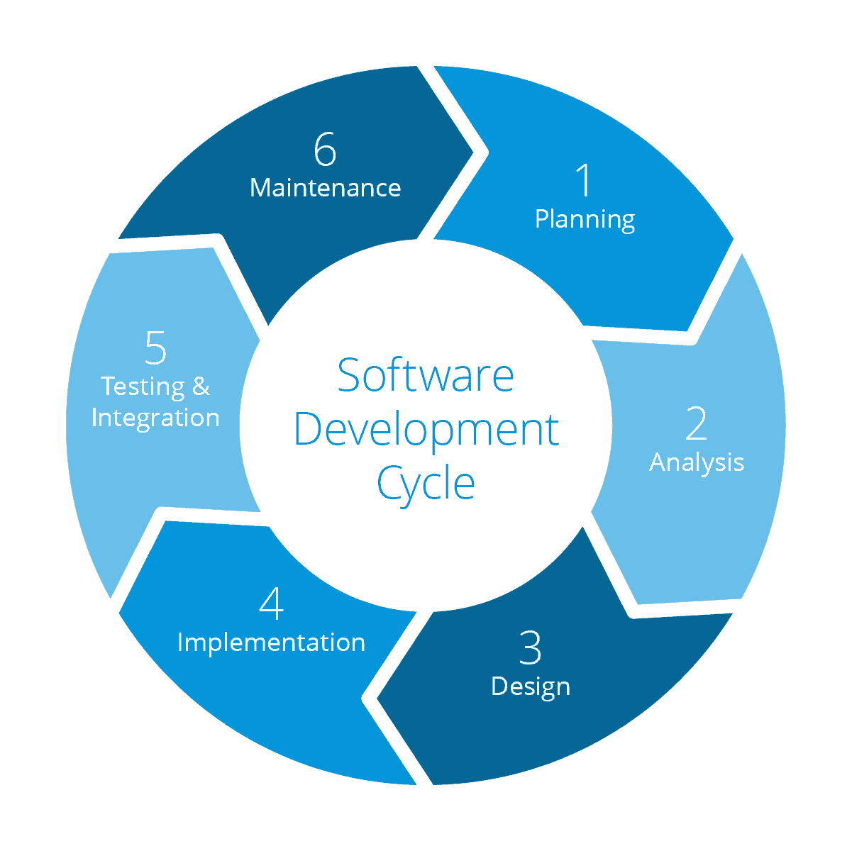
Product Maintenance
Requirement gathering
System Testing
Technology stack selection
Code implementation
and development
UML artifacts design

Slide 16
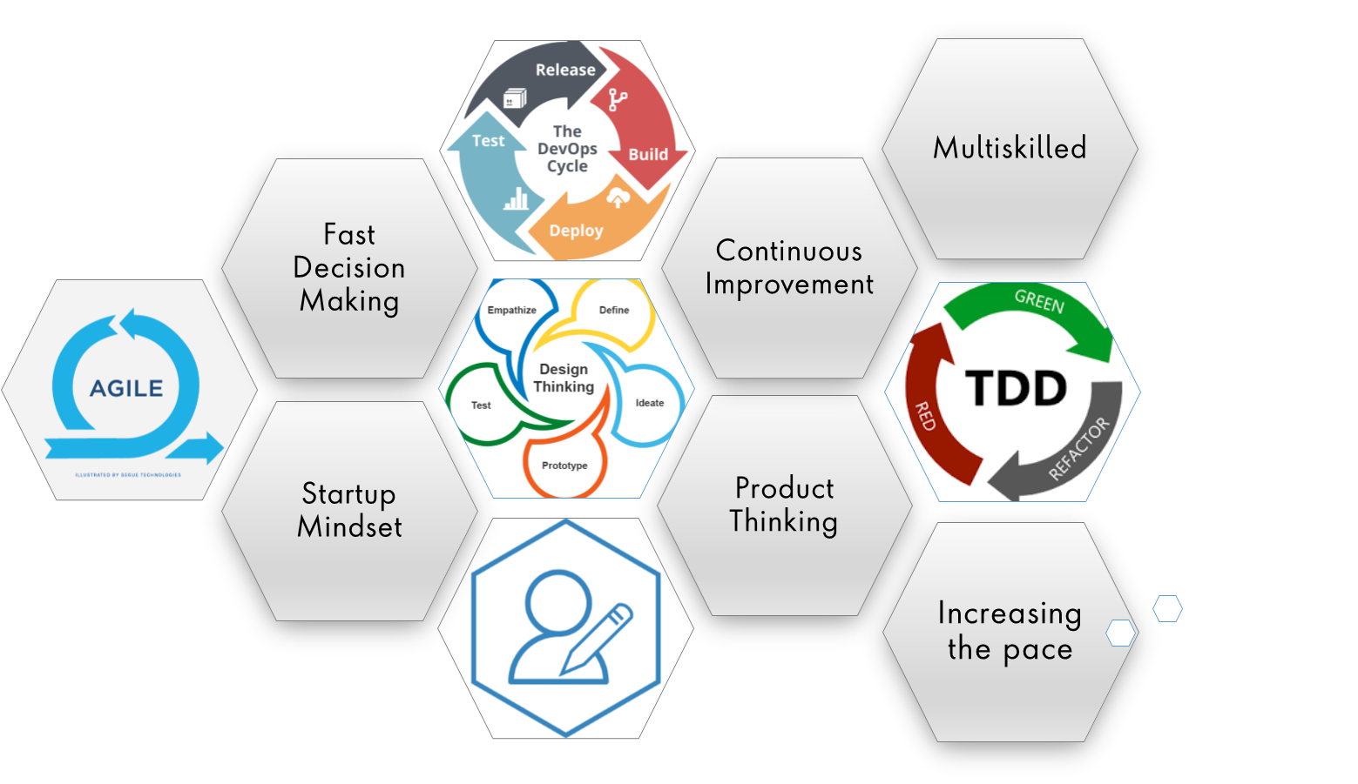
Notes:
Product Thinking (Design Thinking, Requirement Analysis, )
Multi Skilled (Frontend, Backend, DevOps)
Fast Decision Making (Agile)
Increasing the Pace (Automation CI/CD)
Startup Mindset (Agile)
Continuous Improvement (Retros)

Slide 17
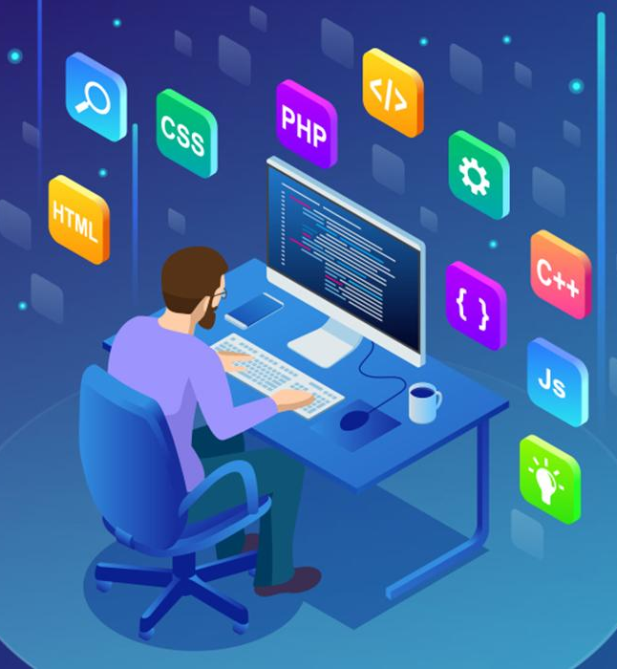
Tech Stack
Notes:
Time – 2 mins

Slide 18










Backend
Data
Tools
Core Language
SQL Database
Documentation
Framework
UI/UX
Version Control
API Testing
Application Server
Notes:
Time – 1 min

Slide 19

Development
Notes:
Time – 1 min

Slide 20
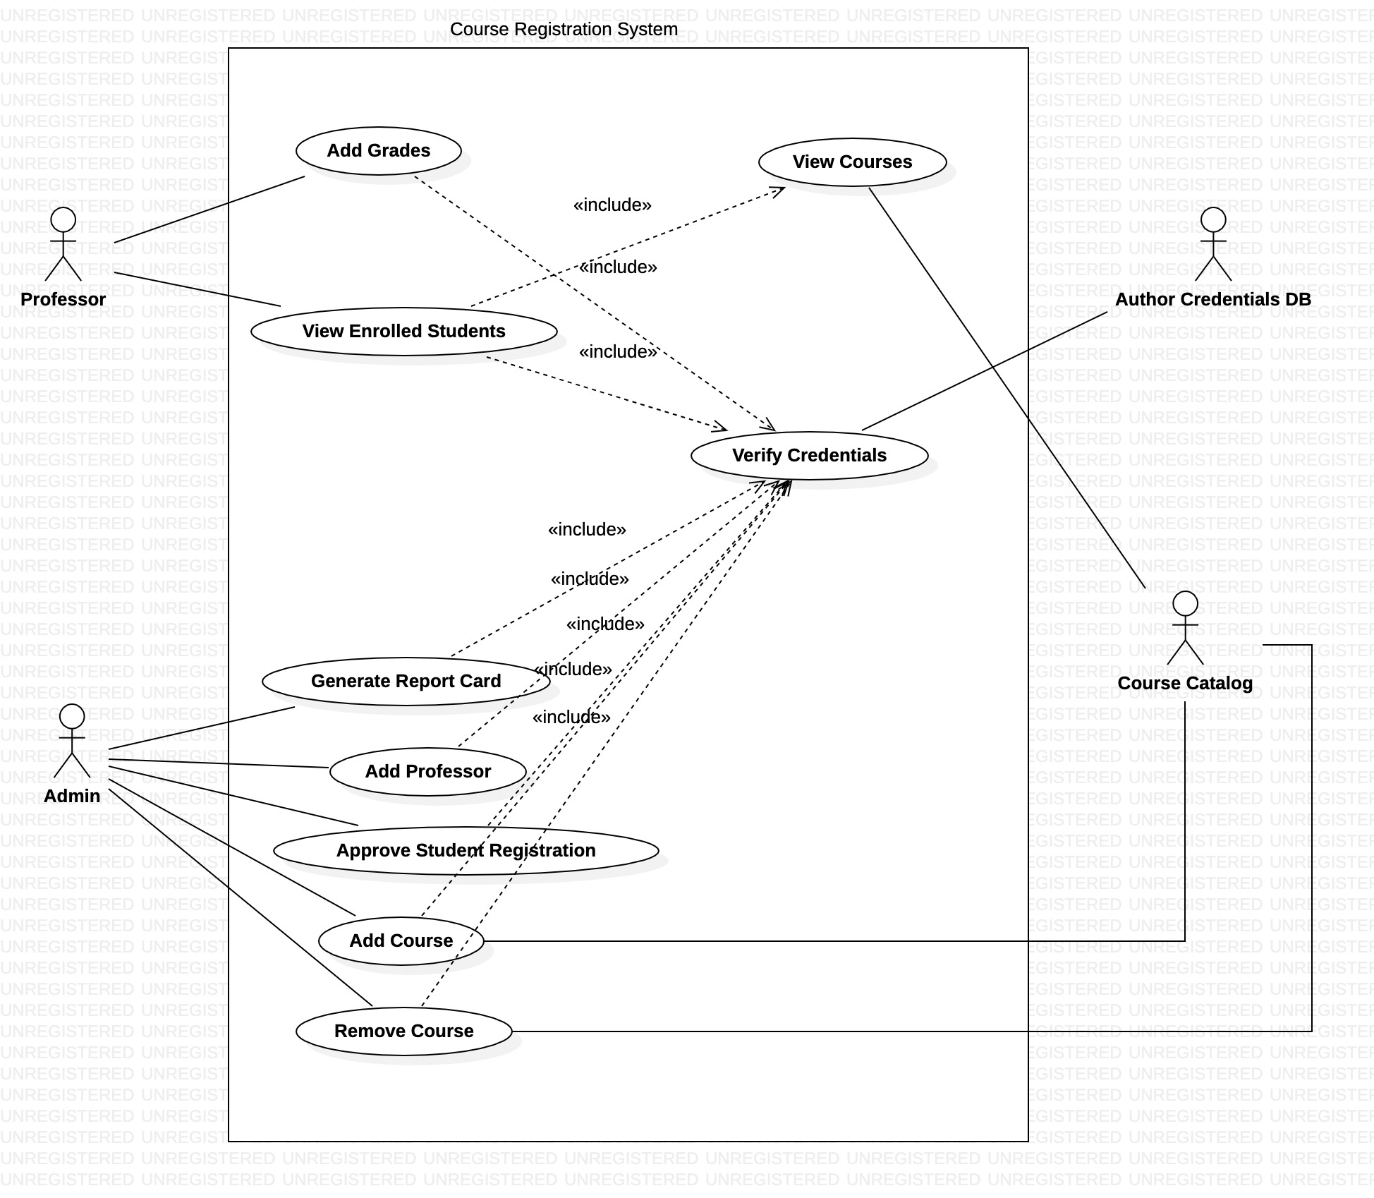
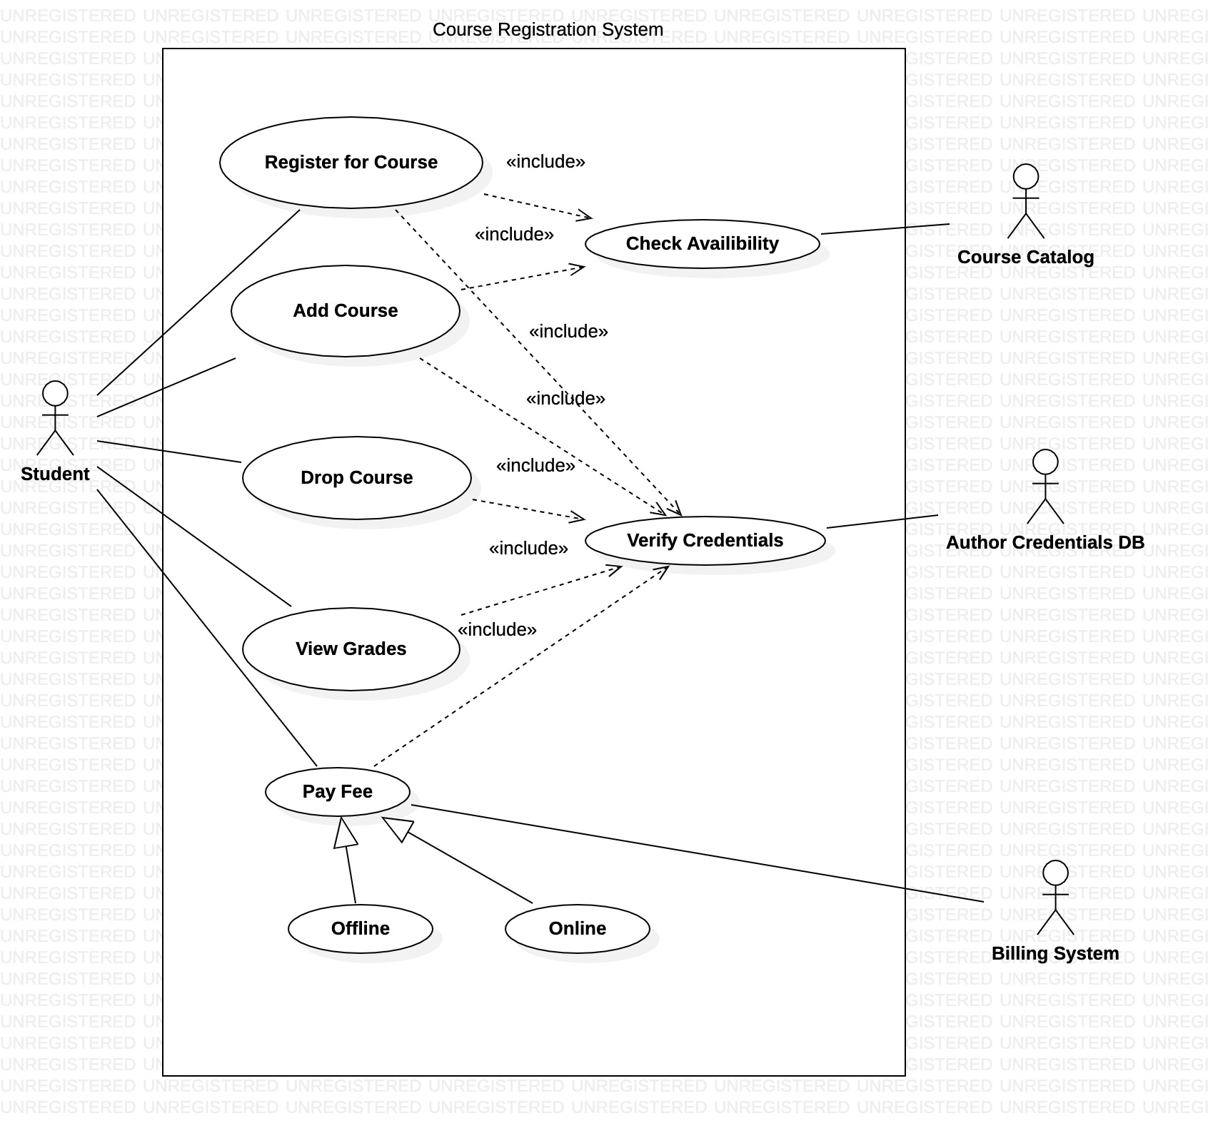
UML Artifacts

Slide 21
Sprint Process
1. Gathering requirement
2. Resource Planning
Requirement understanding
Research and analysis
Estimation
Sprint Planning
Spring Grooming
Delivery
Sprint Implementation
LLD
Development
Code Review
Commit
Integrate
Deploy
Test
Notes:
Time – 1 min

Slide 22

Project Demo
Notes:
Time –
POS- Student -5 min
REST - Professor - 3 min
DropWizard- 3 min

Slide 23

Challenges & Learnings
Notes:
Time – 2 mins
Challenges-
Installing the Tomcat server and running application on it.
Learnings-
Got to learn new technologies.
Learnt working together in teams.(collaboration)
Learnt how to write code which is accepted by the industry.
Learnt how to make UML diagrams for the given problem.

Slide 24

Q & A
Notes:
Time - ?

Slide 25
Thank you
Notes:
Time – After this show the testimonial video. 1 min

